Slide 1


Winnebago County Illinois
2013
Court and Case Management
“Path to Excellence”

Slide 2
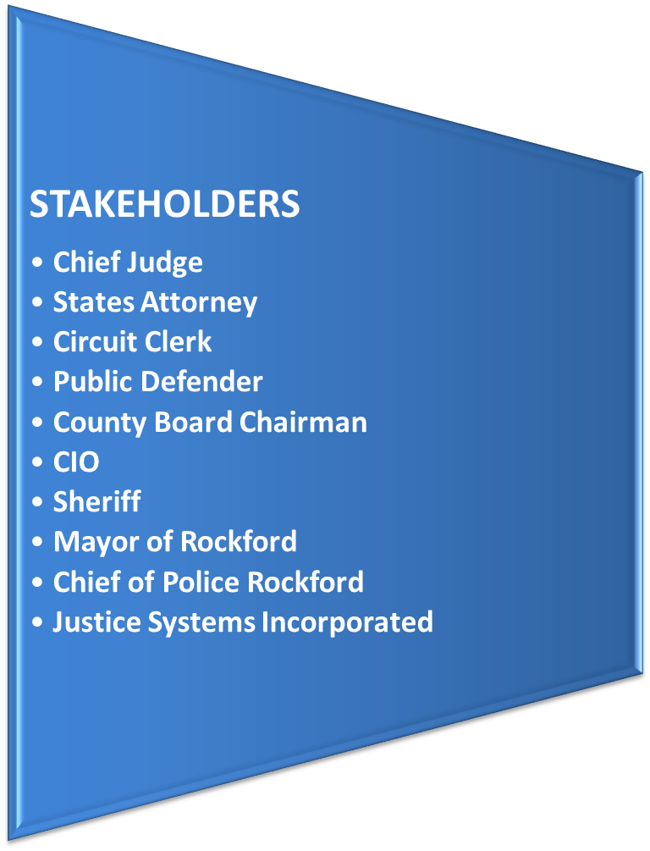
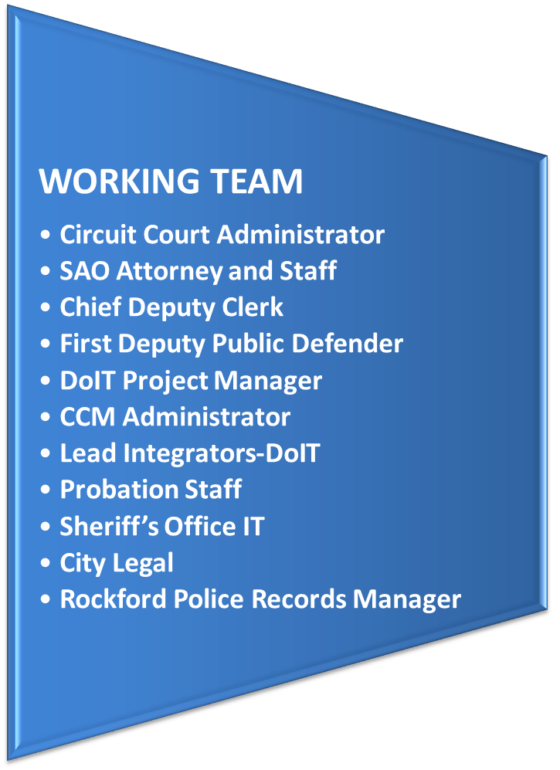
COURT AND CASE MANAGEMENT GOVERNANCE
ICJIA Presentation Winnebago County Illinois February 2013

Slide 3

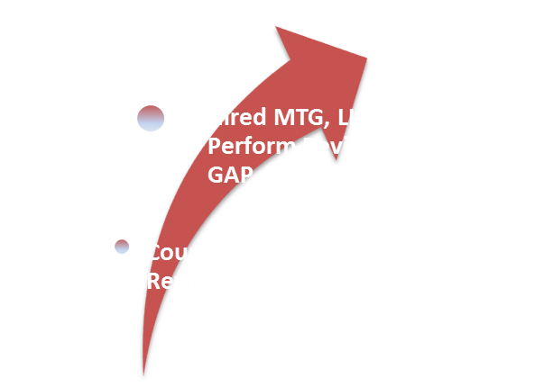
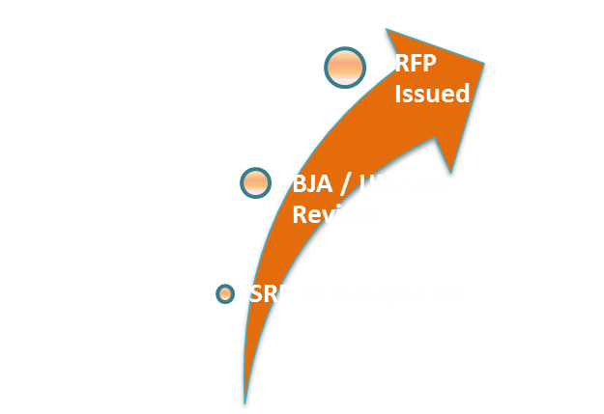
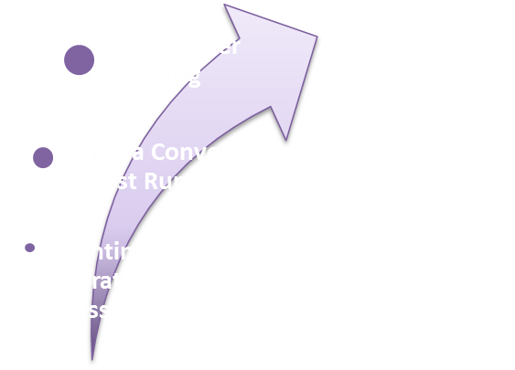
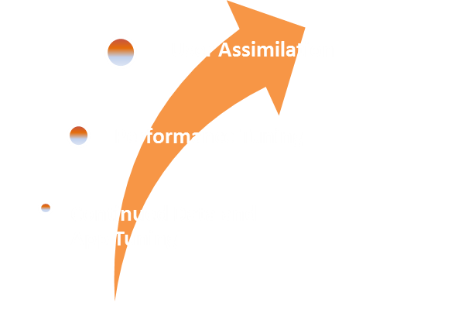
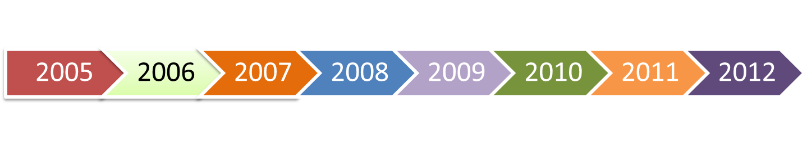
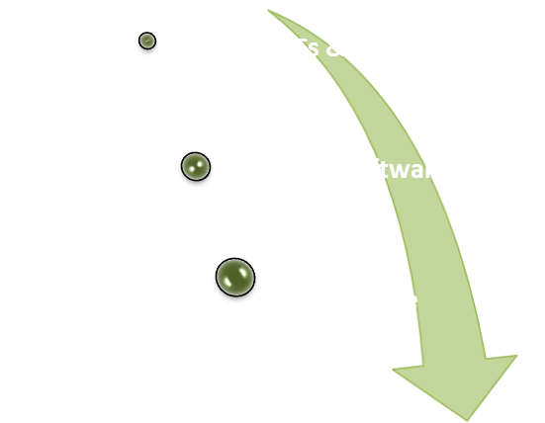
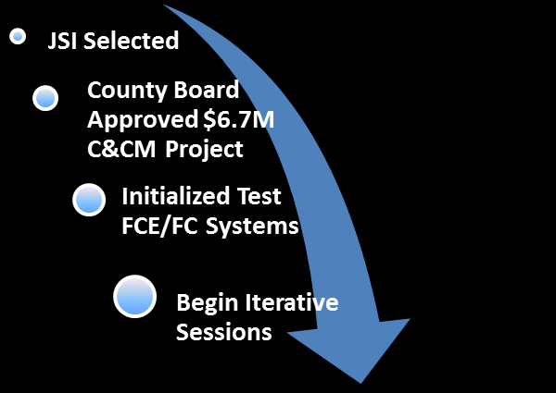

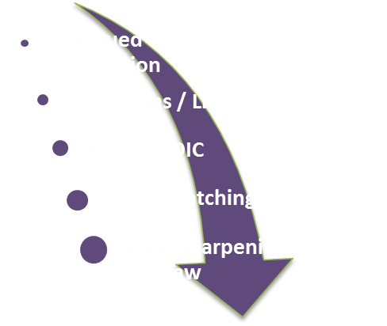
Winnebago County Illinois
Court and Case Management
“Investment in Excellence”
ICJIA Presentation Winnebago County Illinois February 2013

Slide 4
Winnebago County
Sheriff
Background
Sworn Law Enforcement - 125 Corrections Officers - 195 Civilian – 38
New 911 Dispatch Center Software Oct 9th 2006
New Corrections Management Software June 30th 2007
New Records Management Software January 1st, 2008
From the 911 call through Disposition
911 call, Police Records, Corrections, SA, Clerk, Probation, Corrections.
  Two way communications between Corrections and Clerk
  Two way communications between Records and the Clerk/SA
ICJIA Presentation Winnebago County Illinois February 2013

Slide 5
Winnebago County
States Attorney
Improved efficiency responding to public inquiries; easy name/alias lookup, court scheduling (when a case is going to court), case search by victim, determine whether charges are authorized or declined, police report number lookup to find a defendant when victim only knows police report number, easy warrant status lookup.
Jail booking integration, the system saves our office monumental time from having to input all the information from the arrest report by hand.
We have the ability to use charging document templates that populate system information including statutes specific language and defendant information for improved efficiency.
Charging document and case info is then forwarded electronically to the clerk’s office.
Reliable notification/reminders for staff members on such things as subpoenas, victims follow-up, etc. Similar charging document template functionality utilizing merge codes from the system for discovery, letters to victims, warrants…
Attorneys can make case specific notes in the system; other attorneys can quickly reference notes, get up to speed and fill in when required. This ability is setting our office up to go paperless in the future, enabling paper-related cost avoidance.
We are also scanning documentation to the case to prevent lost paperwork (hardcopy).
ICJIA Presentation Winnebago County Illinois February 2013

Slide 6
Winnebago County
Circuit Clerk
Case Initiation – Getting a correct document every time.
Using reminders to alert other departments of specific court events.
Increased financial understanding of fines and cost assessed by other
offices.
Increased accuracy of collections information for Harris & Harris.
ICJIA Presentation Winnebago County Illinois February 2013

Slide 7
Winnebago County
Trial Court Administration
COLLABORATION AMONG ALL JUSTICE RELATED DEPARTMENTS IMPORTANT.
CONSISTENT REPRESENTATION THROUGHOUT ENTIRE PROCESS, IF POSSIBLE.
ESTABLISH A JUDICIAL TECHNOLOGY COMMITTEE.
INTRODUCE TECHNOLOGY INTO COURTROOMS EARLY.
COURTROOMS NEED TO ACCOMMODATE INFRASTRUCTURE REQUIREMENTS.
CREATE MOST COMPREHENSIVE TESTING ENVIRONMENT POSSIBLE.
DEVELOP A STAFF TRAINING PROTOCOL – ALLOW FOR MULTIPLE SESSIONS.
SOFTWARE BENEFITS TO JUDICIARY:
BETTER MANAGEMENT AND CONTROL OF COURT CALENDARS.
ACCESS TO COURT CALENDARS AND CASE RECORDS AT THE BENCH, CHAMBERS AND REMOTE LOCATIONS.
ALLOW JUDGES TO ATTACH CONFIDENTIAL NOTES TO INDIVIDUAL CASES.
ENHANCED REPORTING CAPABILITIES/ PERFORMANCE MEASUREMENT
ICJIA Presentation Winnebago County Illinois February 2013

Slide 8
Winnebago County
Public Defender
What We Have Gained Already
Elimination of Duplicative Data Entry
  Saving Time
  Reducing Staff
Speed & Efficiency
  Quicker Notification of Appointment
  Better Access to Information
  Everyone is Looking at the Same Information
Better Understanding of the Criminal Justice Process
  We Understand Them Better
  They Understand Us Better
Stronger Management Capabilities
  Attorneys
  Support Staff
  Investigators
ICJIA Presentation Winnebago County Illinois February 2013

Slide 9
Winnebago County
Court Services
SUCCESSES
Change in thinking
Process adaptation
Enhanced access to Court documents
Interdepartmental communication
Statistical/historical reporting
CHALLENGES
Software modifications
User buy-in
Training
Converted Data
Decreased autonomy
ICJIA Presentation Winnebago County Illinois February 2013

Slide 10
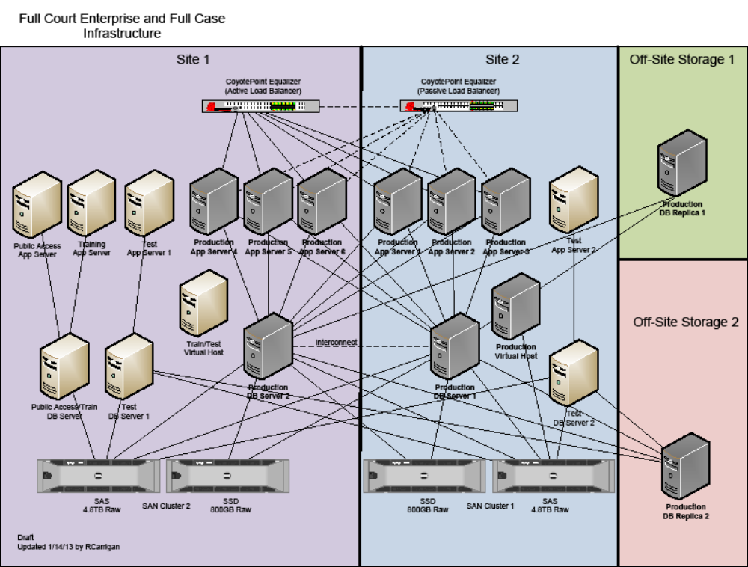
ICJIA Presentation Winnebago County Illinois February 2013

Slide 11
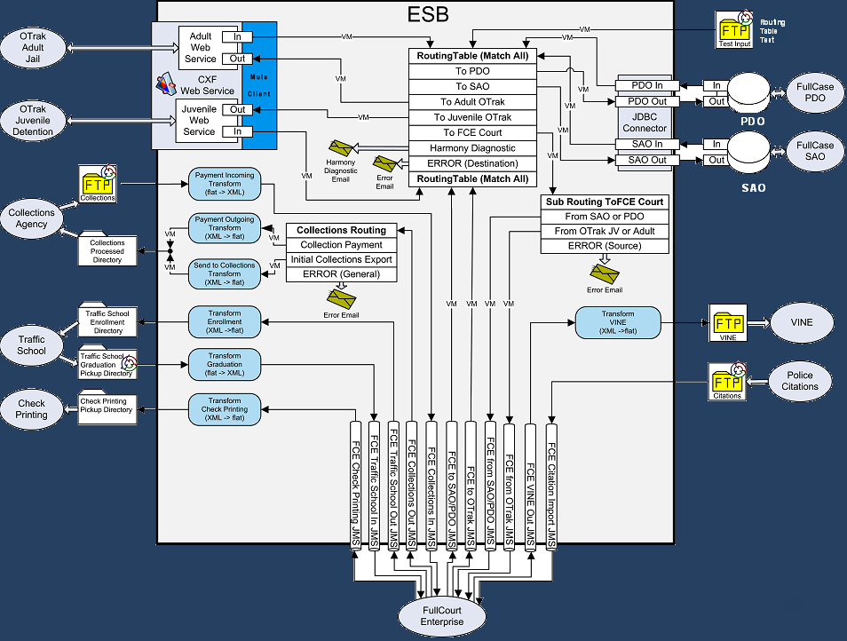
ICJIA Presentation Winnebago County Illinois February 2013

Slide 12
Winnebago County
Futures
E-Filing
E-Ticketing
Path to paperless
Judges/staff embracement of technology
Dashboards
Collections
Child Protection Data Collection
Plea Negotiation
Real Time Courtroom Processing (from the courtroom to the shelf)
ICJIA Presentation Winnebago County Illinois February 2013

